Slide 1

Patient’s Condition Classification Using Drug Reviews
Team 6 :
Mr. Yogesh Ananda Chappewar
Miss. Ankitha Sunny
Mr. Pawar Priya Rajendra
Kasbe Amol Sahebroa
Mr. Rupali Sharma
Mr. Anuj Kumar
Mr. Beereddy Ravi Sushanth Reddy
Mentor Name: Madishetti Rajashekar

Slide 2
Business Problem
This is a sample dataset which consists of 161297 drug name, condition reviews and ratings from different patients and our goal is to examine how patients are feeling using the drugs their positive and negative experiences so that we can recommend him a suitable drug. By analysing the reviews, we can understand the drug effectiveness and its side effects.
The dataset provides patient reviews on specific drugs along with related conditions and a 10 star patient rating reflecting overall patient satisfaction.
So in this dataset, we can see many patients conditions but we will focus only on the below, classify the below conditions from the patients reviews
a. Depression
b. High Blood Pressure
c. Diabetes, Type 2

Slide 3
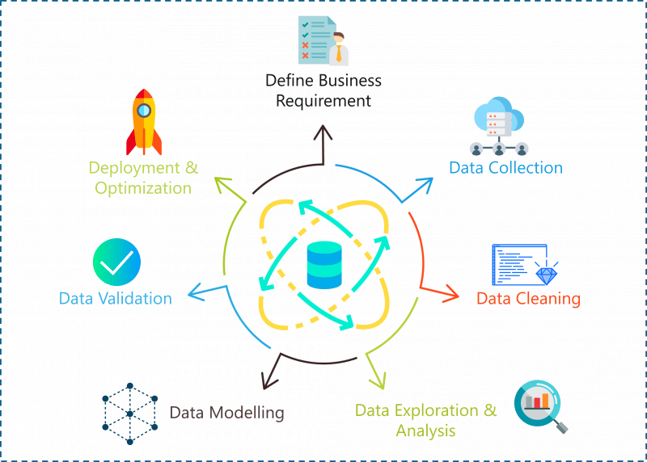
Project Architecture / Project Flow

Slide 4
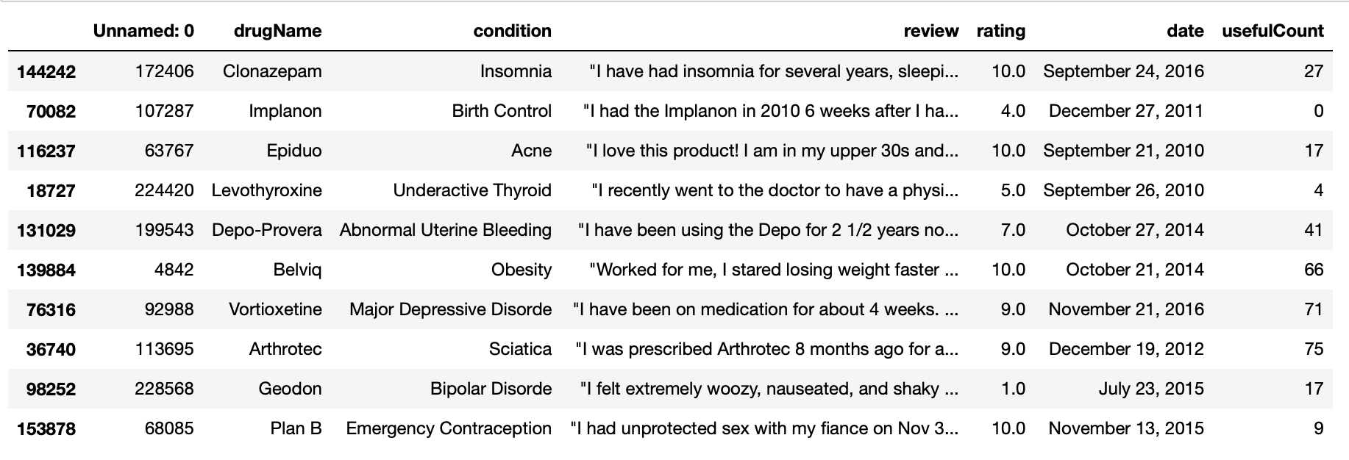
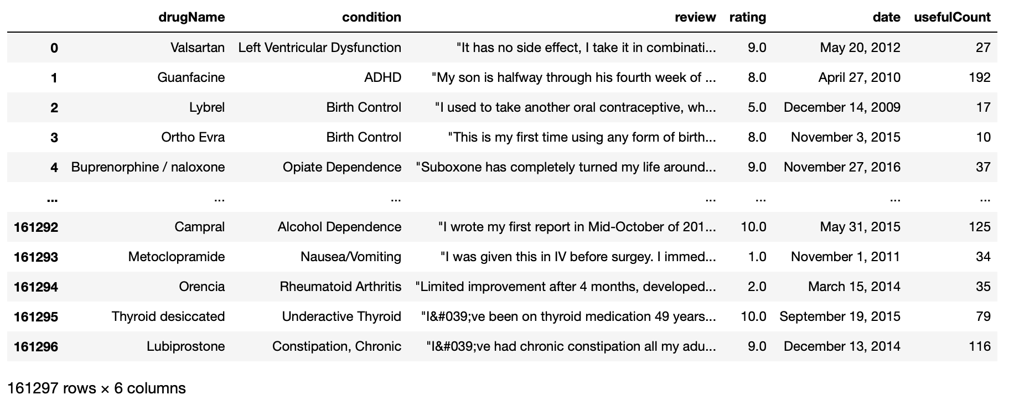
Data Understanding
After dropping the column (Unnamed:0) There are 161297 rows and 6 columns(drugName, condition, review, rating, date, usefulCount) in our dataset.

Slide 5
Exploratory Data Analysis (EDA)

Slide 6
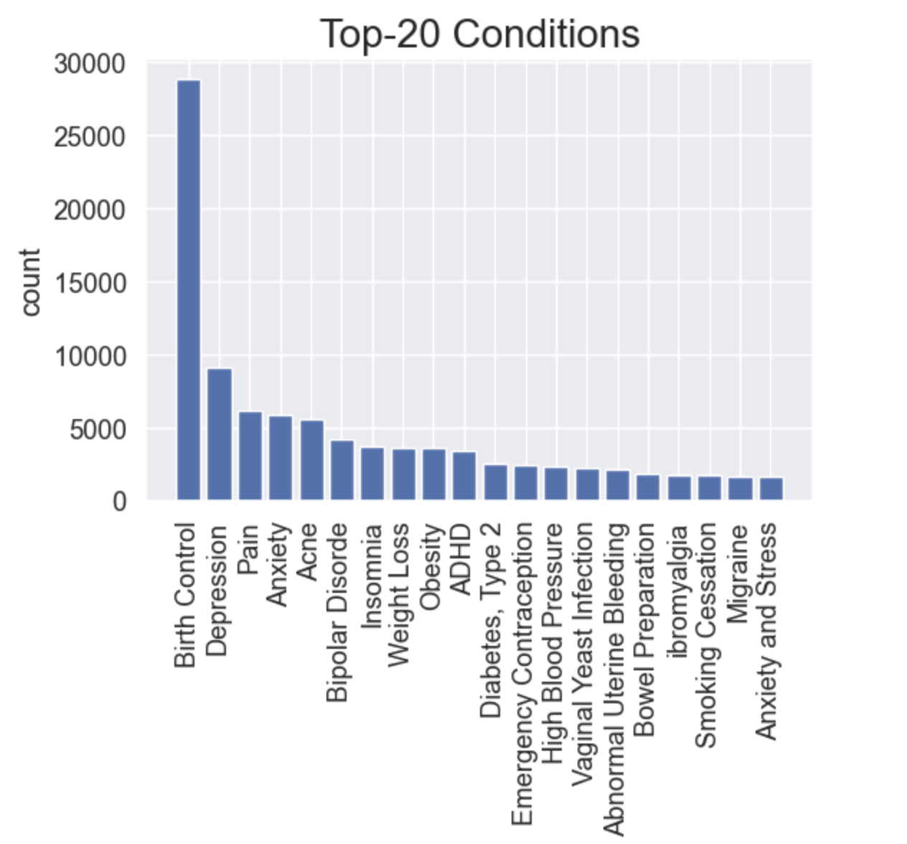
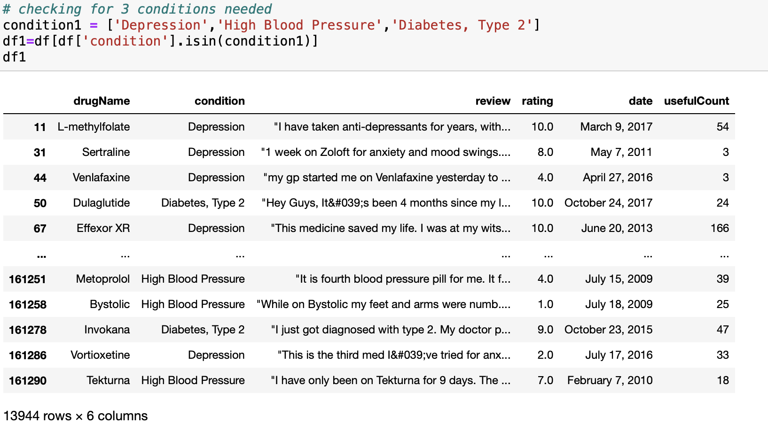
EDA
Plotted a bargraph showing the top 20 conditions
Filtered data set based on the required 3 conditions:
Depression
High Blood Pressure
Diabetes, Type 2

Slide 7
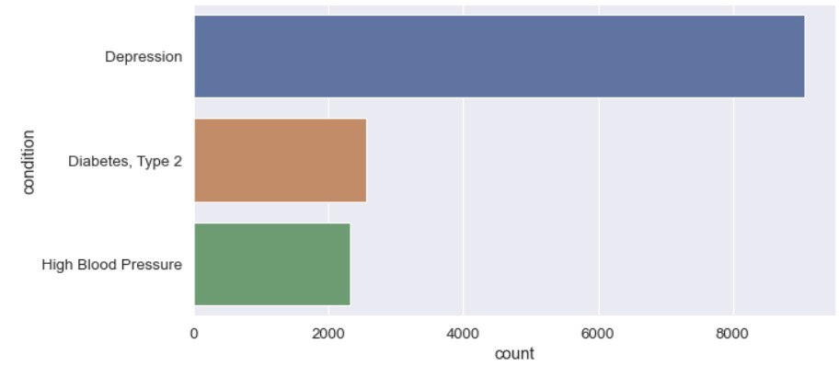
Bar graph showing the count of the 3 required conditions

Slide 8
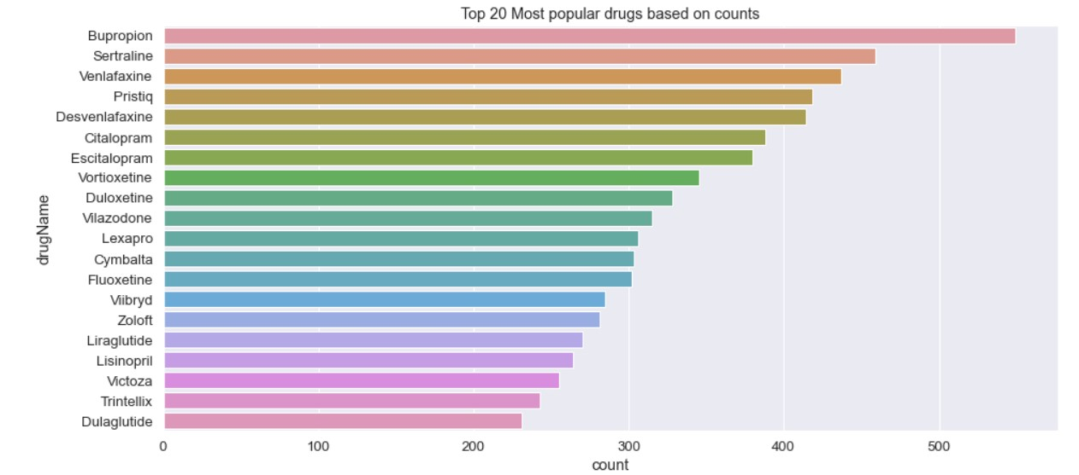
Bar graph showing top 20 drugs based on count

Slide 9
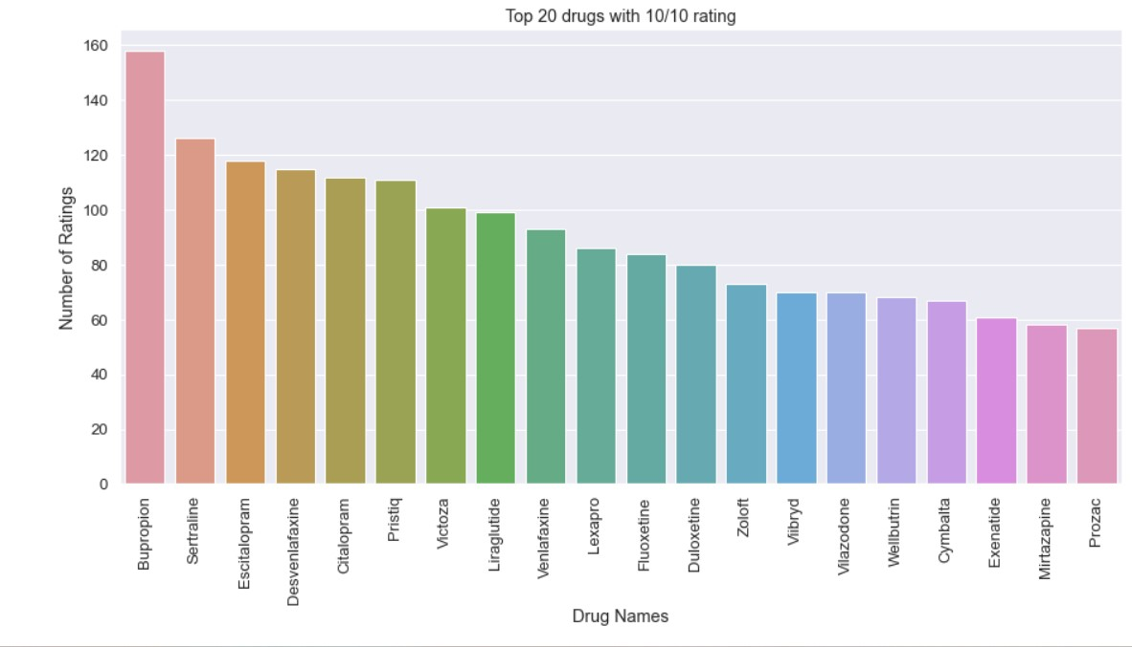
Bar graph showing top 20 drugs based on Rating 10/10

Slide 10
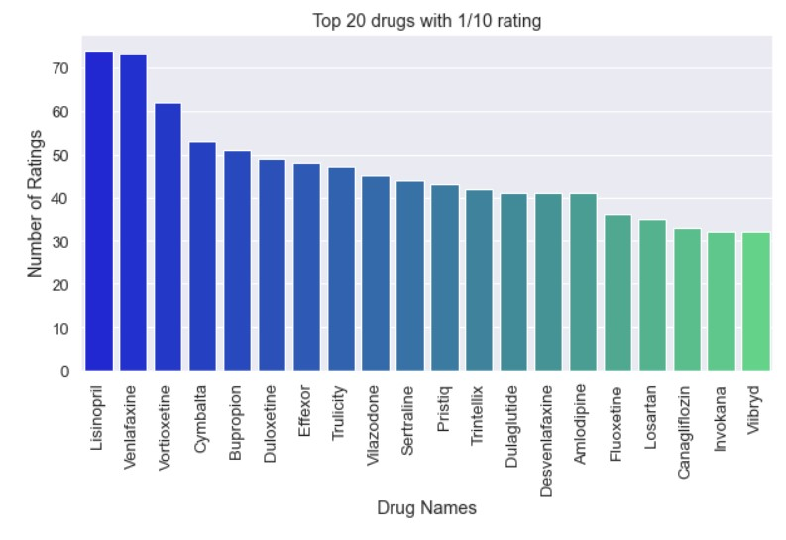
Bar graph showing top 20 drugs based on Rating 1/10

Slide 11
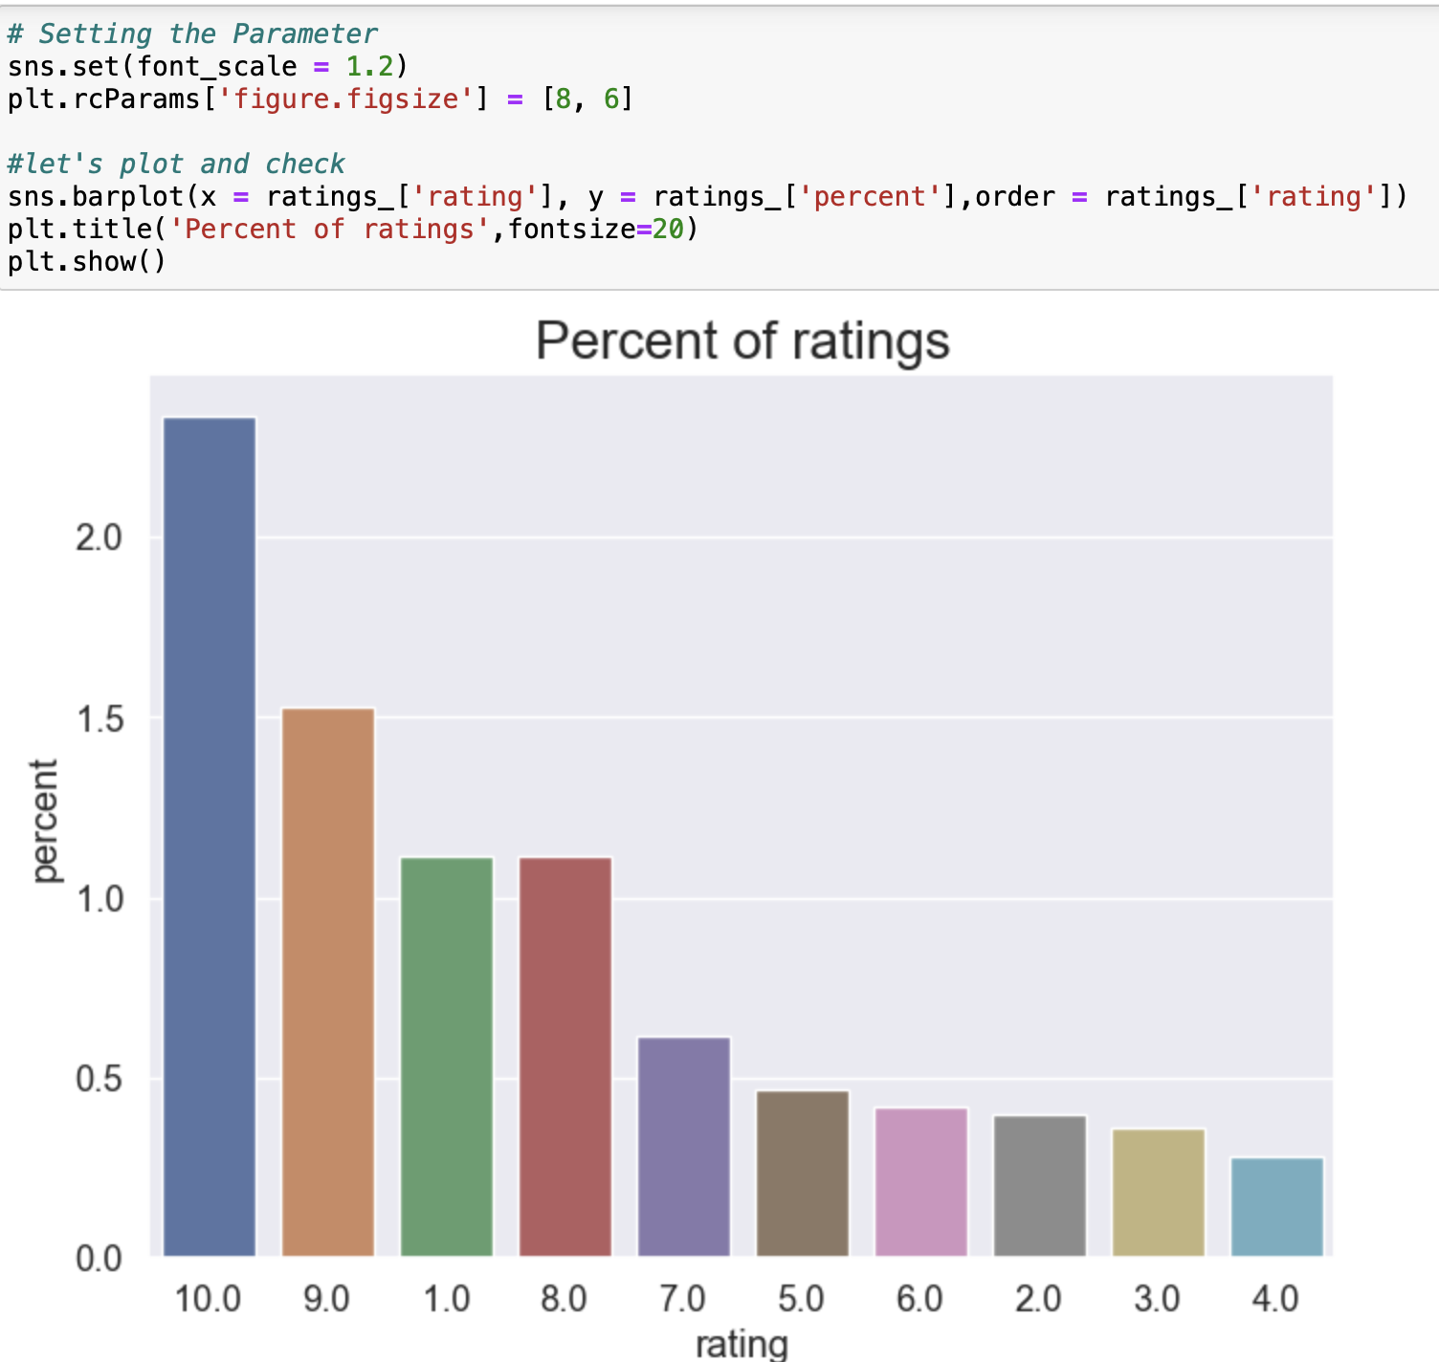
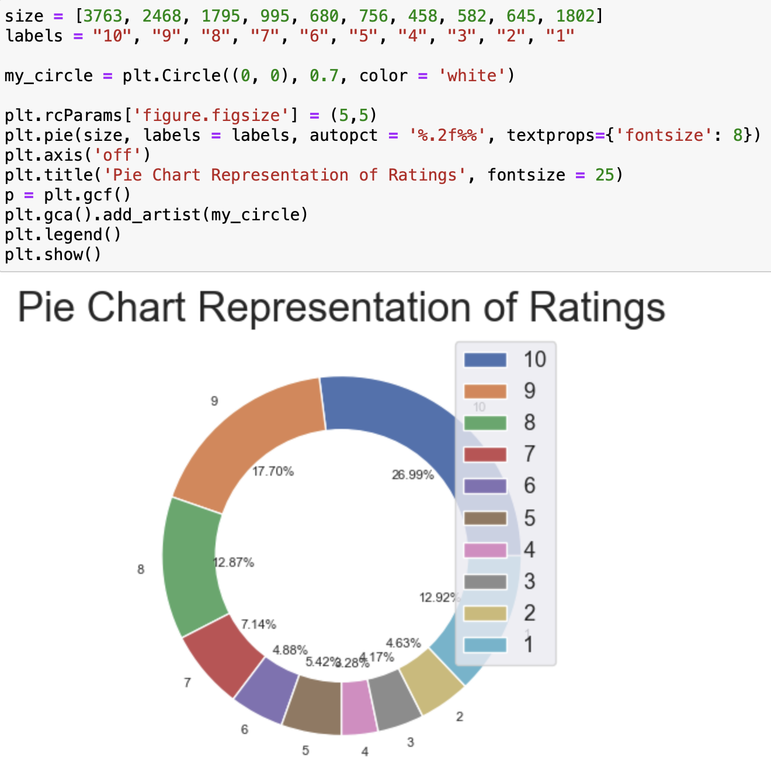
Bar graph showing rating distribution and Pie chart representation of rating

Slide 12
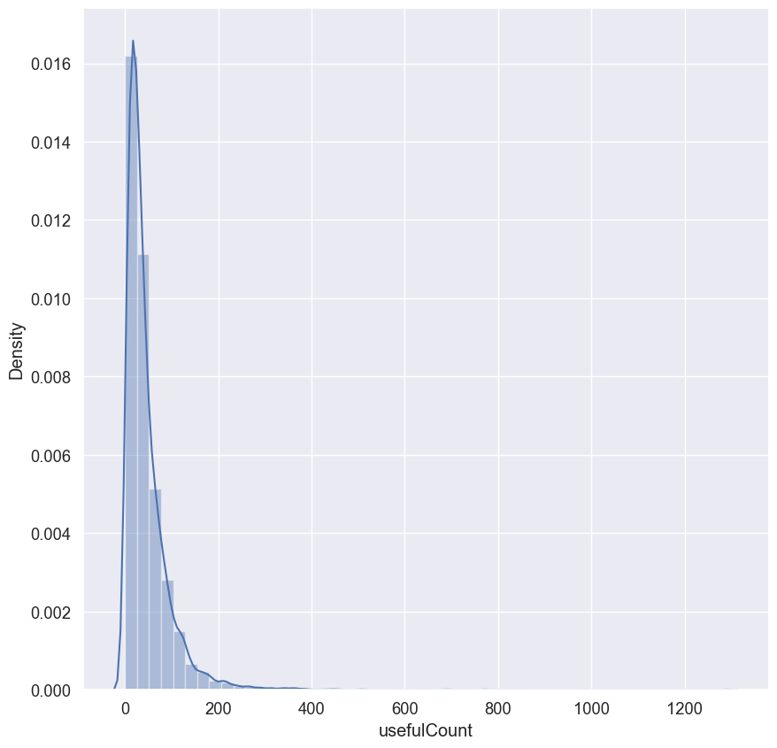
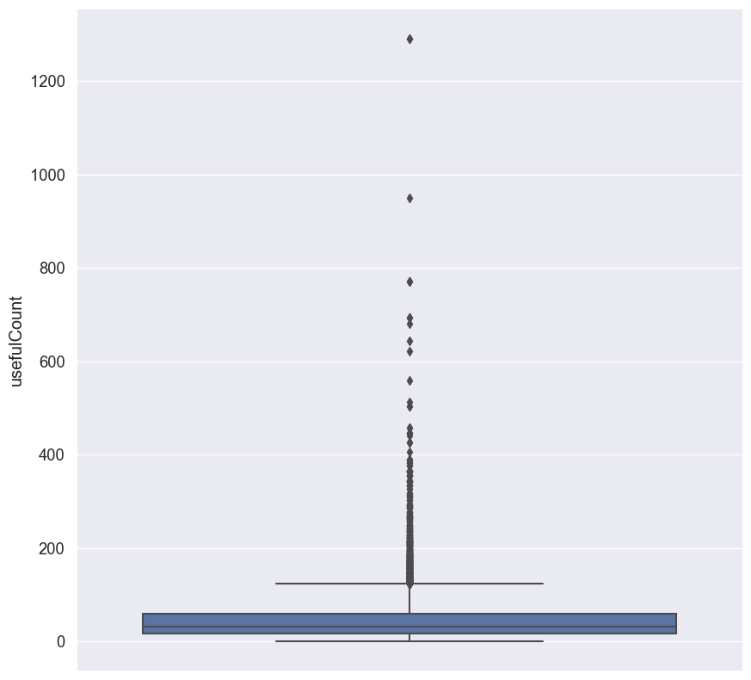
Distplot and descriptive summary of usefulCount column
We can see that there are huge outliers present in our dataset.
Some drugs have extreme useful counts.

Slide 13
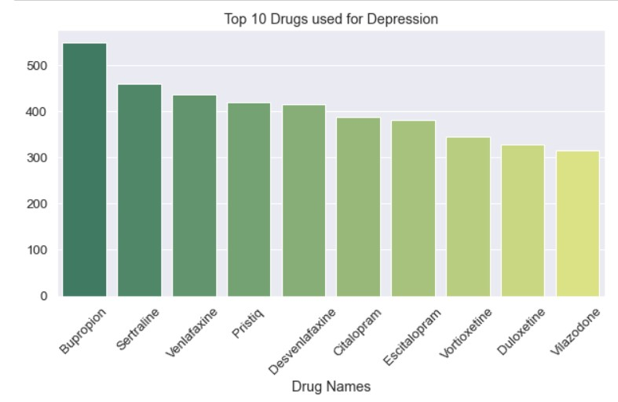
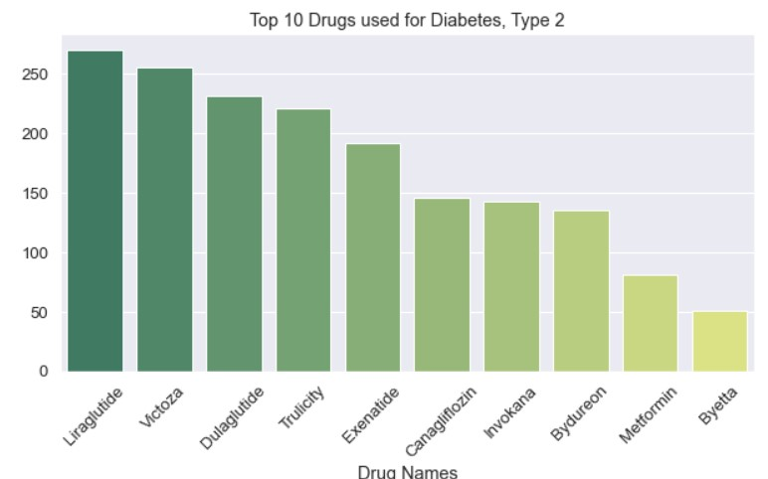
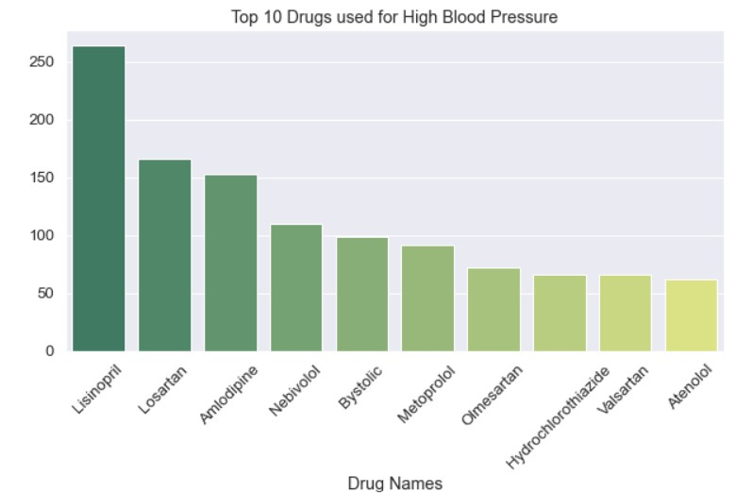
Top 10 Drug names for Depression, Diabetes, Type 2 and High Blood Pressure

Slide 14
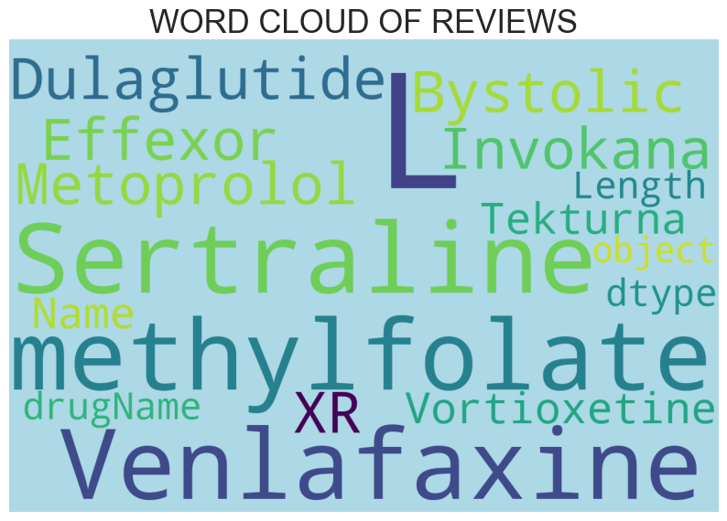
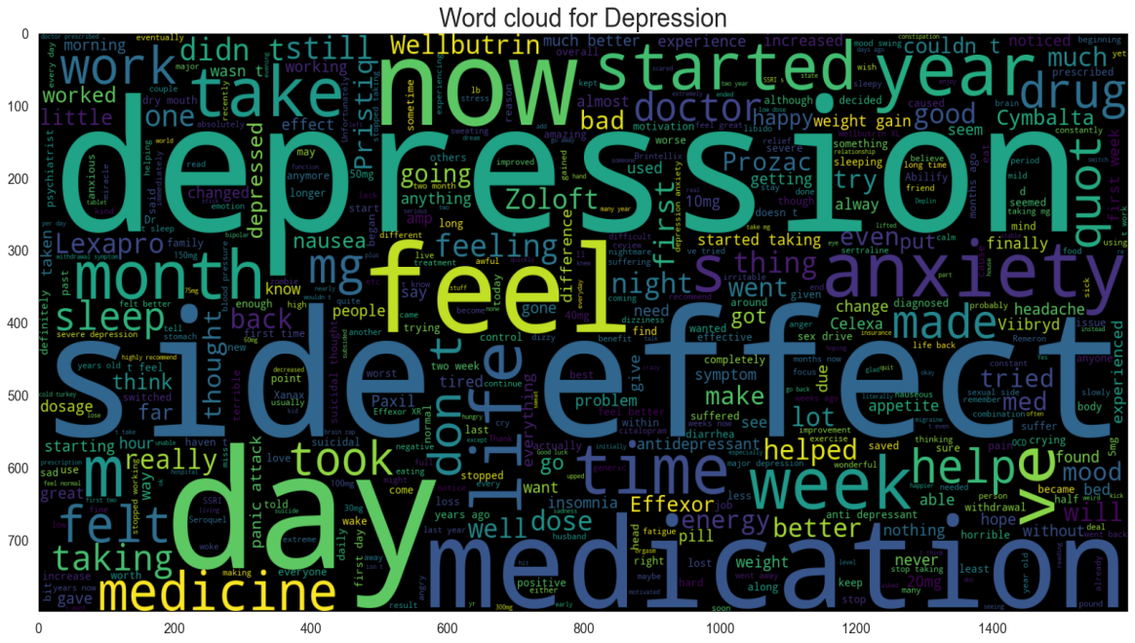
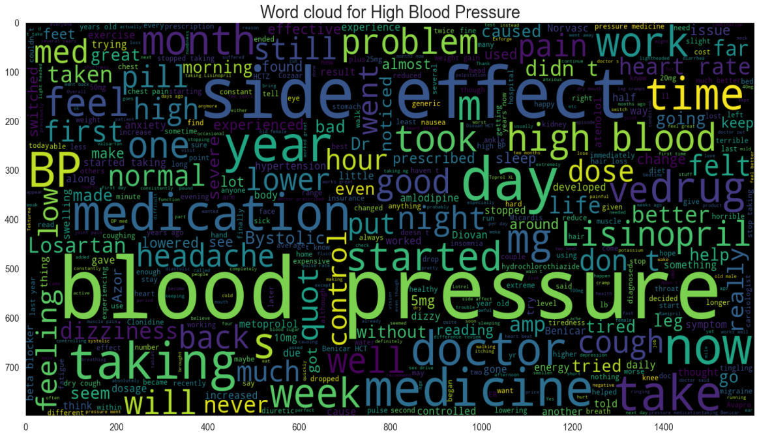
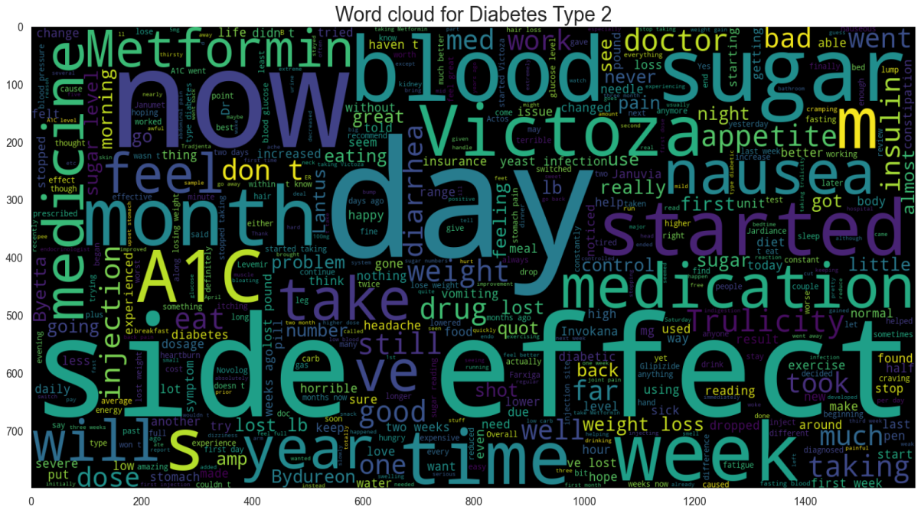
Word Cloud of Reviews and the 3 conditions:

Slide 15
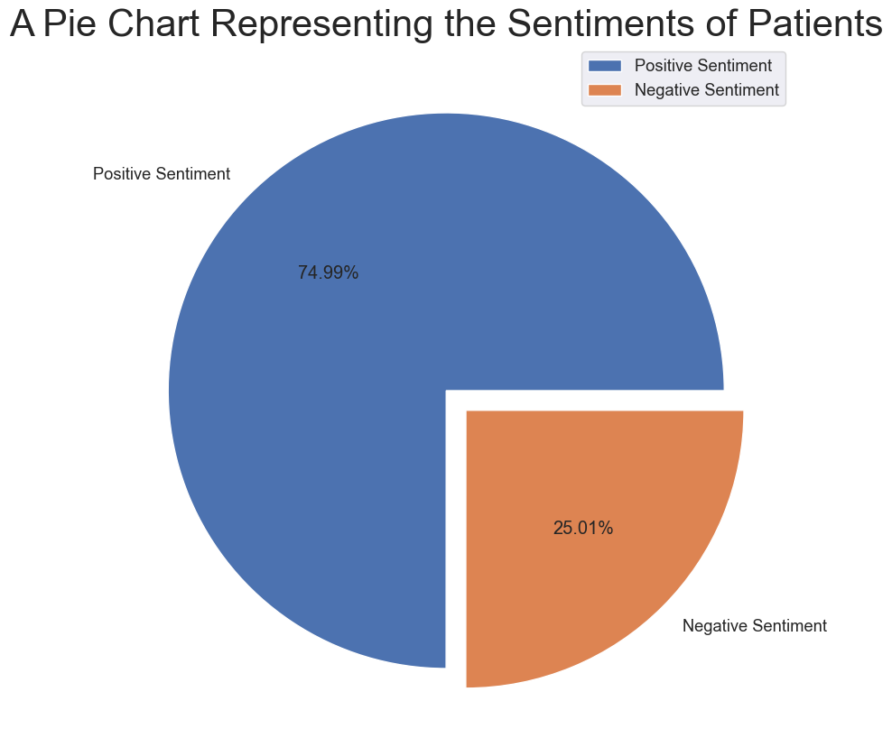
Pie Chart representing the sentiments of the patients:

Slide 16
Data Preprocessing and Model Building

Slide 17
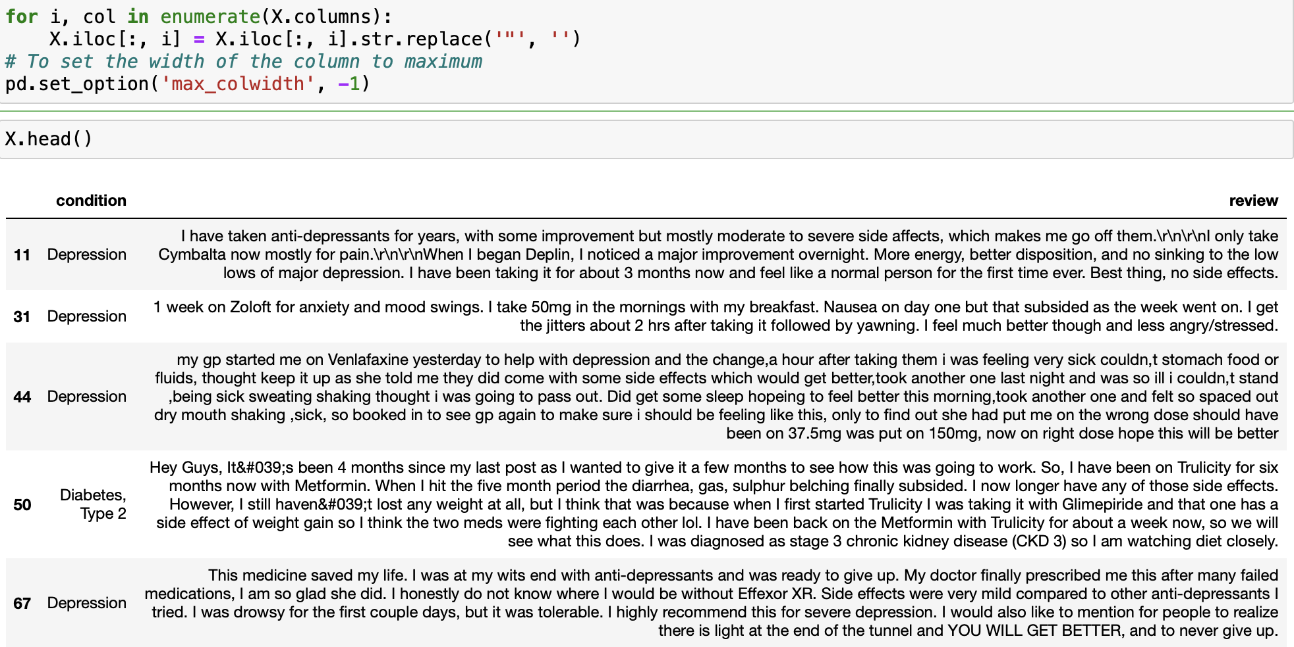
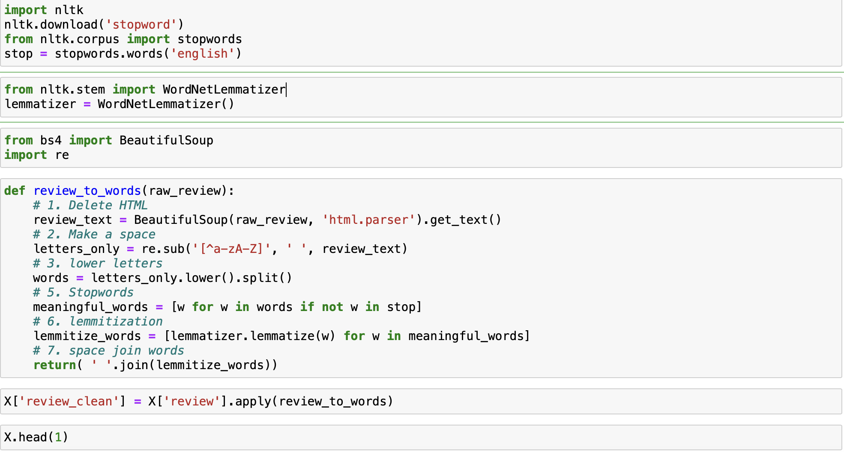
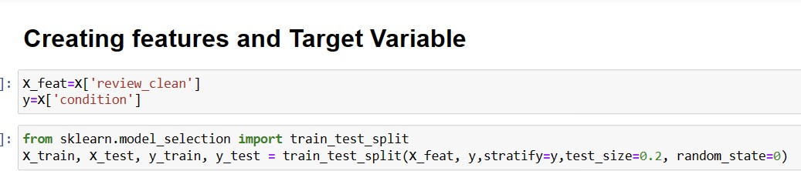
Data Cleaning and Train – test Split

Slide 18
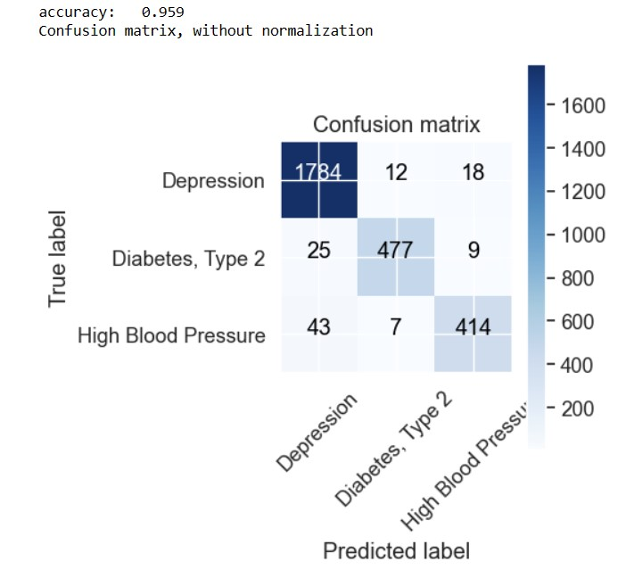
1. LOGISTIC REGRESSION MODEL
Confusion matrix and accuracy based on logistic regression model

Slide 19
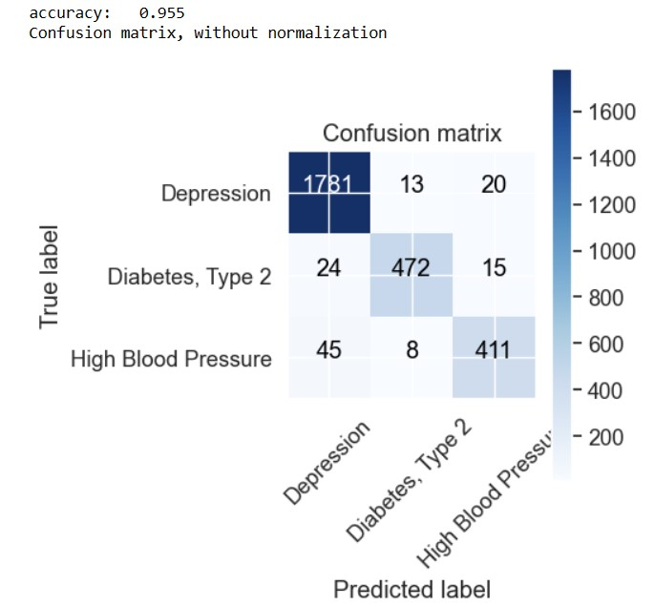
1. MULTINOMIAL NB MODEL
Confusion matrix and accuracy based on multinomialNB model

Slide 20
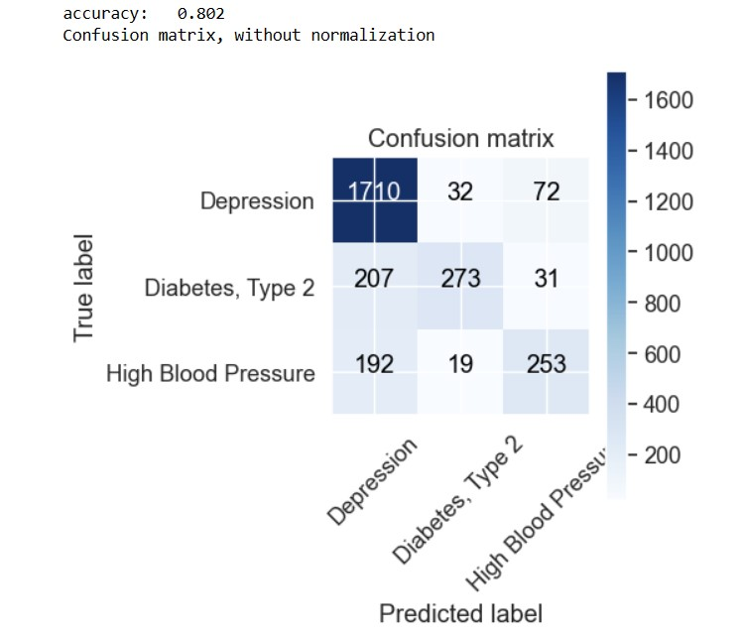
1. KNN MODEL
Confusion matrix and accuracy based on KNN model

Slide 21
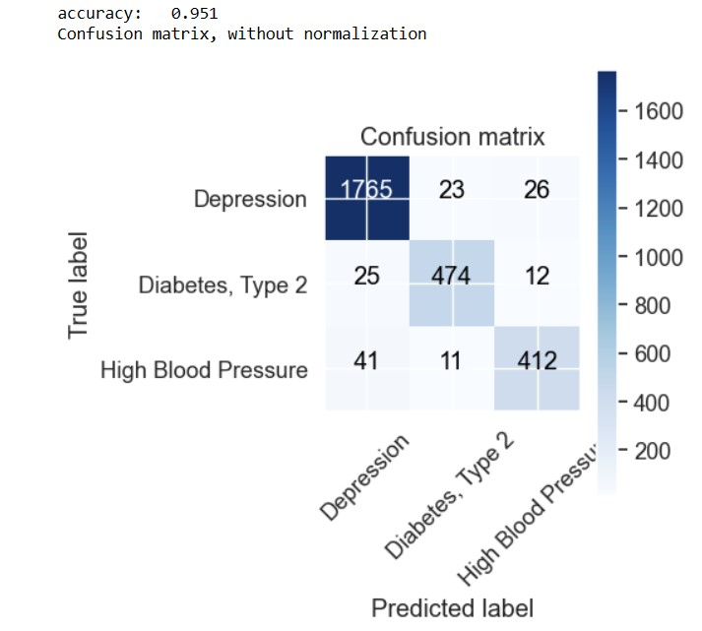
1. Passive Aggressive Classifier model
Confusion matrix and accuracy based on Passive Aggressive Classifier model

Slide 22
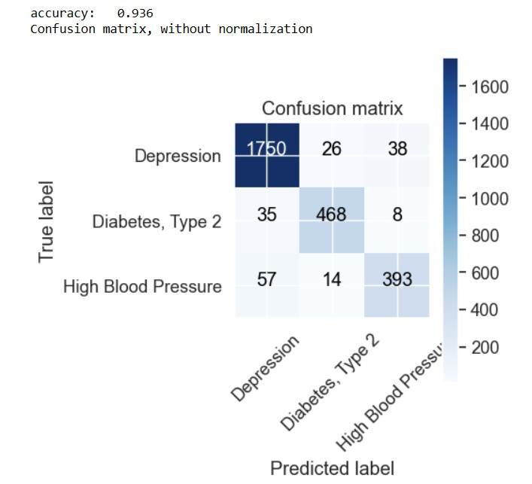
1. Decision Tree model
Confusion matrix and accuracy based on Decision Tree model

Slide 23
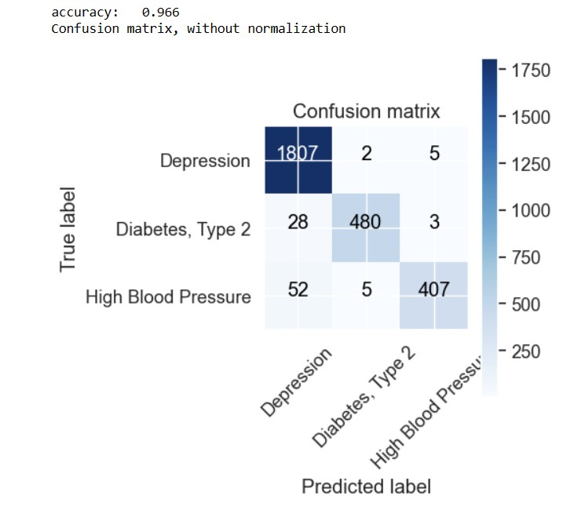
1. Random Forest model
Confusion matrix and accuracy based on Random Forest model

Slide 24
Accuracy Comparison
 | Methods | Accuracy
1 | KNN | 80.172105
2 | Decision_Trees | 93.570742
3 | Passive_Aggressive | 95.050018
4 | Multinomial_Bayes | 95.518107
5 | Logistic_Regression | 95.912513
6 | Random_Forest | 96.629616
RF model is having the highest accuracy

Slide 25
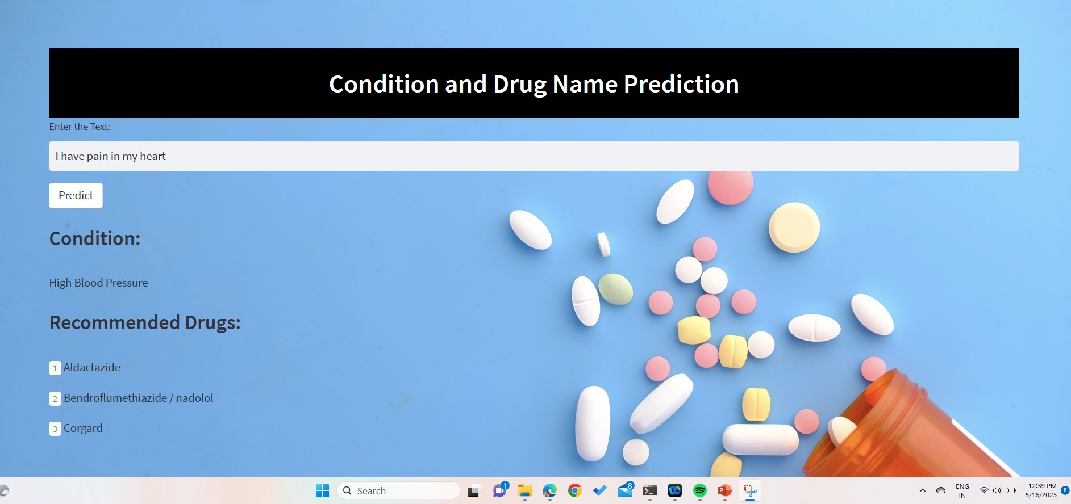
DEPLOYMENT – STREAMLIT APP
The Deployment is done with Streamlit:

Slide 26
THANK
YOU!

